Slide 1
20XC15 -Problem Solving and C Programming
Arrays and Strings

Slide 2
Outline
Introduction
Declaration of strings
Initialization of strings
Reading strings
Writing strings
String handling functions
Array of strings

Slide 3
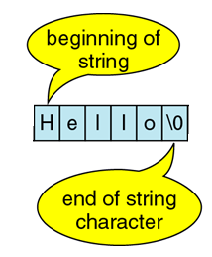
Arrays and Strings
A string is a sequence of characters treated as a group
In C - no explicit type, instead strings are maintained as arrays of characters
  ie., Strings are 1-dimensional arrays of type char
By convention, a string in C is terminated by the end-of-string sentinel \0 (or null character)
Representing strings in C
  stored in arrays of characters
  array can be of any length
  end of string is indicated by a delimiter, the zero character ‘\0’

Slide 4
Features of Strings
C has no native string type, instead we use arrays of char
A special character, called a “null”, marks the end
This may be written as ’\0’
This is the only character whose ASCII value is zero
Depending on how arrays of characters are built, we may need to add the null by hand, or the compiler may add it for us

Slide 5
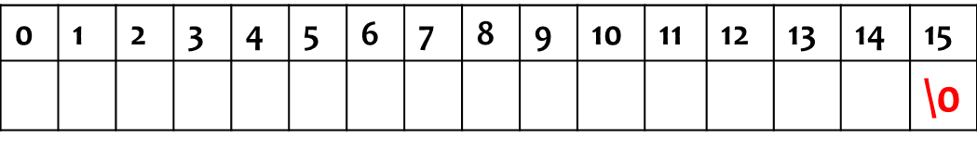
Arrays and Strings
Declaration
Syntax : char name_of_string[length];
char name[16];
  char is data type.
  Name_of _string is user defined name given to string variable.
  [length]: defines the size of the string
Declares a char name of maximum length 15 characters (elements 0 to 14, element 15 stores the null character)
The only way to store a string or a line of text in C language is storing individual characters in a character array

Slide 6
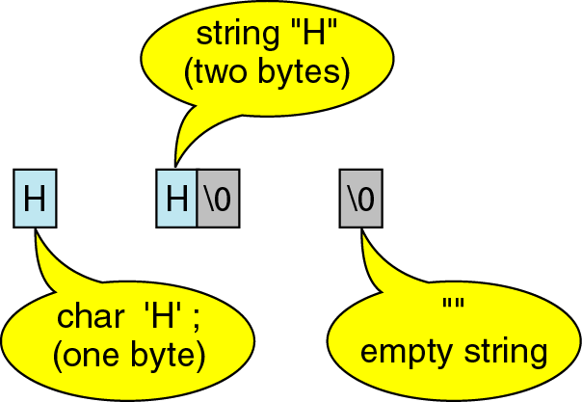
Arrays and Strings
A string containing a single character takes up 2 bytes of storage
char str = ‘H’;
char str[ ] = “H”;
char str[ ] = “” ;

Slide 7
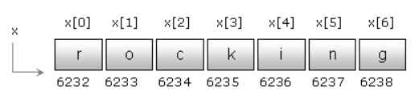

Arrays and Strings
Initialization
  char x[ ]={'r', 'o', 'c', 'k', 'i', 'n', 'g'};
  char x[ ]= "rocking";

Slide 8
Arrays and Strings
#include <stdio.h>
int main()
{
char x[ ]={ 'r','o','c','k','i','n','g‘ };
char y[ ]="rocking";
printf("Size of character array %d",sizeof(x));
printf("\nSize of string %d",sizeof(y));
return 0;
}
Output:
Size of character array 7
Size of string 8

Slide 9
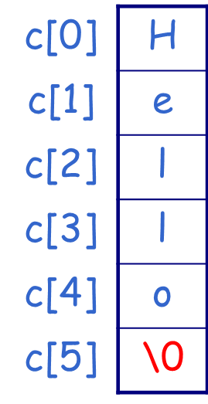
Arrays and Strings
char c[5] = { 'H', 'e', 'l', 'l', 'o' };
Note : If the number of initializers is equal to the declared size, the size may be omitted. e.g. char c[ ] = { 'H', 'e', 'l', 'l', 'o' };
char name[9] = { ‘P’, ‘S’, ‘G’, ‘ ‘, ‘T’, ‘E’, ‘C’, ‘H’ };
If the number of initializers is less than the declared size,
the remaining elements are initialized to null character('\0')
e.g. char c[6] = { 'H', 'e', 'l', 'l', 'o' };
If the number of initializers is more than
the declared size, the complier will produce
a warning message
e.g. char c[4] = { 'H', 'e', 'l', 'l', 'o' };
warning: excess elements in array initializer

Slide 10
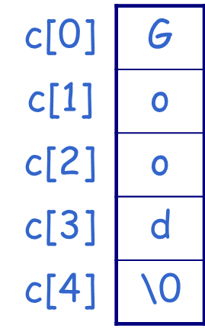
Arrays and Strings
Using string
char c[5] = { "Good" };
char c[5] = "Good";
char c[ ] = "Good";
Note: The array c consists of 5 elements but not 4 elements! This declaration is equivalent to:
char c[5] = "Good";
It differs with
char c[4] = "Good";
char c[ ] = { ‘G’, ‘o’, ‘o’, ‘d’, ‘\0’ };
  Note: we cannot separate the initialization from declaration.
  char str3 [5] ;
  str3 = ”GOOD”; /* not allowed. */

Slide 11
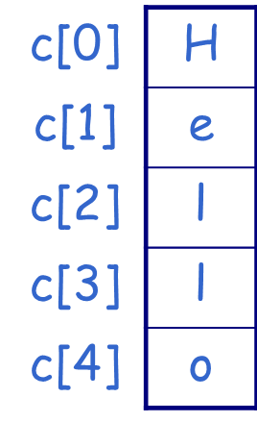
Arrays and Strings
Assignment
In a character array, each element stores one character
e.g. char c[5];
c[0]='H';
c[1]='e';
c[2]=c[3]='l';
c[4]='o';
Assigning ASCII Values
c[0]=72;
c[1]=101;
c[2]=c[3]=108;
c[4]=111;
Note: Characters can be interpreted as integers
  char c = ‘A’;
  printf(“%c\n”,c); prints A
  printf(“%d\n”,c); prints 65
  printf(“%c\n”,65); prints A

Slide 12
Arrays and Strings
Note
Use %s field specification in scanf to read string ignores leading white space
  reads characters until next white space encountered
  C stores null (\0) char after last non-white space char
  Reads into array (no & before name, array is a pointer)
Input and output
#include<stdio.h>
int main()
{
char x[100];
printf("Enter a line of text:");
scanf("%s",x);
printf("The given text is : %s",x);
return 0;
}
To read a string including blank space using scanf, use search set.
scanf("%[^\n]", x);
Enter a line of text : hello world
The given text is : hello

Slide 13
Arrays and Strings
Edit set input %[ListofChars]
  ListofChars specifies set of characters (called scan set)
  Characters read as long as character falls in scan set
  Stops when first non scan set character encountered
  Note, does not ignored leading white space
  Any character may be specified except ]
  Putting ^ at the start to negate the set (any character BUT list is allowed)
Examples
  scanf(“%[-+0123456789]”,number);
  scanf(“%[^\n]”,Line); /* read until newline char */

Slide 14
Arrays and Strings
Use %s field specification in printf
  characters in string printed until \0 encountered
  char Name[10] = “Rich”;
  printf(“|%s|”, Name); /* outputs |Rich| */
Can use width value to print string in space:
  printf(“|%10s|”,Name); /* outputs | Rich| */
Use - flag to left justify:
  printf(“|%-10s|”,Name); /* outputs |Rich | */

Slide 15
Arrays and Strings
Input
a ↵
b ↵
c ↵
Output
a
b
c
Using %c
#include<stdio.h>
int main()
{ char str[6];
int i;
for ( i=0; i < 6; i++ )
scanf ( "%c", &str[i] );
for ( i= 0; i < 6; i++ )
printf ( "%c", str[i] );
}
Input
abcde↵
Output
abcde

Slide 16
Arrays and Strings
Using %c
#include <stdio.h>
int main()
{ char str[6];
int i;
for ( i = 0; i < 6; i++ )
scanf ( “ %c", &str[i] );
// Note the blank space before %c
for ( i = 0; i < 6; i++ )
printf ( "%c", str[i] );
}
Input
a ↵
b ↵
c ↵
d ↵
e ↵
Output
abcde

Slide 17
Arrays and Strings
Using %s
#include <stdio.h>
int main()
{ char str[ ] = {‘H', 'e', 'l', 'l', 'o'} ;
printf("%s", str);
}
Output
Hello$
#include <stdio.h>
int main()
{ char str[ ] = "Hello";
printf("%s", str);
}
Output
Hello

Slide 18
Arrays and Strings
Using %s
#include<stdio.h>
int main()
{ char a[5] = { 'H', 'e', 'l', 'l' };
printf ( "%s", a );
}
Output
Hell
Note: Uninitialized char array locations
are automatically initialized to \0
#include<stdio.h>
int main()
{ char a[4] = { 'H', 'e', 'l', 'l' };
printf ( "%s", a );
}
Output
Hell$

Slide 19
Arrays and Strings
Using %s
H | e | l | l | \0 | 0 | ! | \0
#include<stdio.h>
int main()
{ char a[ ] = {'H', 'e', 'l', 'l', '\0', 'o', '!', '\0'}; printf ( "%s", a );
}
Output
Hell
Note : The output begins from the base address of "a" and ends when it encounters the first null character

Slide 20
Arrays and Strings
Using %s
#include<stdio.h>
main()
{ char a[15], b[5], c[5];
scanf ( "%s%s%s", a, b, c );
printf ( "a=%s\nb=%s\nc=%s\n", a, b, c );
}
"blank space" or "tab" or "newline" marks the end of the input string
Input
How are you? ↵
a
b
c
H
o
w
\0
a
r
e
\0
y
o
u
?
\0

Slide 21
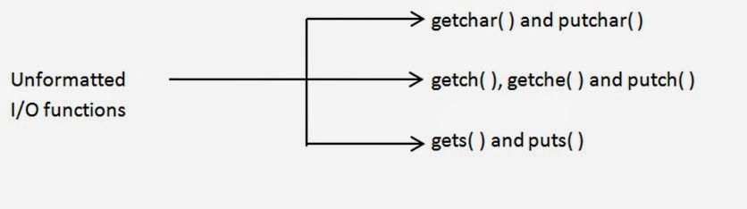
Arrays and Strings
Unformatted Input/output for strings

Slide 22
Arrays and Strings
puts( )
  Syntax: puts (str);
  str is the name of a character array
  After it outputs the string, it moves the cursor to the next line automatically
#include<stdio.h>
int main()
{ char c[ ] = "How do you do?";
puts ( c );
puts ( "I'm OK. Thank you." );
}
Output
How do you do?
I'm Ok. Thank you.
_

Slide 23
Arrays and Strings
gets( )
  Syntax : gets (str);
  str is the name of a character array
  It is used to read a line of text.
  Only the "newline" character marks the end of the input string. The "blank space" and "tab" will be read in as a character in the string.
main()
{ char c[50];
gets ( c );
puts ( c );
}
Input
How are you?
Output
How are you?
_

Slide 24
Arrays and Strings
#include<stdio.h>
int main()
{
char x[100];
printf("Enter a line of text:");
gets(x); //scanf(“%10S”,name);
printf("The given text is : %s",x); // puts(x);
return 0;
}
Execution
Enter a line of text : hello world
The given text is : hello world

Slide 25
Arrays and Strings
getchar() and putchar()
getchar() - reads only one character at a time
putchar() – prints one character at a time
#include<stdio.h>
int main()
{
char name[20], ch;
int i=0;
printf("What's your name?\n");
while((ch=getchar())!='\n')
{
name[i]=ch;
i++;
}
name[i]='\0';
printf("Your name is ");
for( i=0; name[i]!='\0'; i++)
putchar(name[i]);
return 0;
}

Slide 26
Arrays and Strings
getch(), getche() and putch()
The functions getch() and getche() are used to read a character from the keyboard, similar to getchar()
char ch;
ch = getch(); /*Typed character will not be displayed on the screen*/
ch = getche(); /*Typed character will be displayed on the screen*/
putch(ch) – prints the character stored in the variable ch

Slide 27

Arrays and Strings
getch()
# include<stdio.h>
int main()
{
int i=0,j;
char pass[23],c;
printf("enter your password\n");
while((c=getch())!=‘\t’)
{
pass[i++] = c;
printf("*");
}
pass[i] = '\0';
printf("the password that you have entered is %s",pass);
}

Slide 28
Arrays and Strings
getche()
  It reads a single character from the keyboard and displays immediately on output screen without waiting for enter key
  Syntax : int getche( );
Output
Enter the character : s
Entered character : s
#include <stdio.h>
#include<conio.h>
int main() {
char ch;
printf("Enter the character : ");
ch = getche();
printf(“\nEntered character : %c", ch); // putch(ch);
return 0;
}

Slide 29
Arrays and Strings
char s[100], c;
int k;
Input and Output – %s
Question: We want to input a string "This is a string.". Can the following statements read in this string correctly?
(A) scanf ( "%17s", s );
(B) for ( k = 0; k < 17; k++ )
s[k] = getchar();
(C) k = 0;
while ( ( c = getchar() ) != '\n' )
s [k++] = c;
s [k] = 0; //s[k] = ‘\0’;




Slide 30
string.h
A string in C is a sequence of zero or more characters followed by a NULL \0 character
The standard library for C string functions is string.h
string.h – includes many useful string handling functions
To use built-in string handling functions include
#include<string.h>

Slide 31
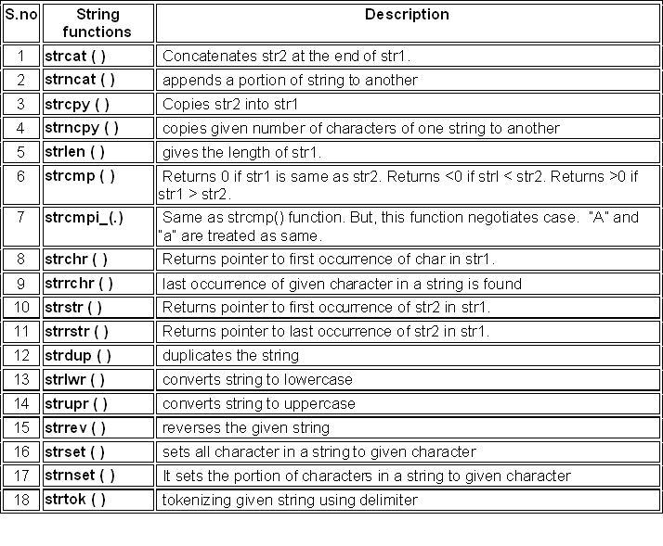
Commonly used String Functions

Slide 32
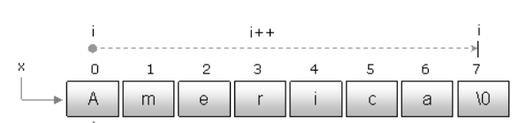
String Handling Functions
strlen()
strlen() is a predefined function in the header file “string.h” used to find the length of string
strlen() does not count Null (\0) character
Syntax
int strlen(const char *str);

Slide 33
Arrays and Strings
strlen()
#include<stdio.h>
#include<string.h>
int main()
{
char x[50];
int len;
printf("Enter any string:");
scanf("%s", x);
len=strlen(x);
printf("The length of string %d",len);
return 0;
}
Execution
Enter any string: America
The length of string 7

Slide 34
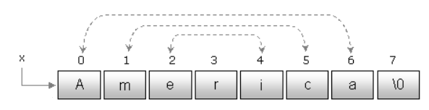
Arrays and Strings
Reversing a string
strrev() is a predefined function defined within the header file “string.h” used to reverse a string
It accepts the address of a string as an argument and reverses the string
Syntax
char *strrev(char *str);

Slide 35
Arrays and Strings
#include<stdio.h>
#include<string.h>
int main()
{
char x[50];
int i;
printf("Enter any string:");
scanf("%s",x);
strrev(x);
printf("The reverse string : %s", x);
return 0;
}
Execution
Enter any string : PSG
The reverse string : GSP

Slide 36
Arrays and Strings
Copying a string
strcpy() is a predefined function defined with in the header file “string.h” used to copy a string onto another
Syntax
char* strcpy(char* dest, const char* src);
copies the characters (including the \0) from the source string (src) to the destination string (dst)
dst should have enough space to receive entire string (if not, other data may get written over)
return value is the destination string (dst)
Note
It replaces the content of destination string by the content of source string
It does not affect the source string. The source string remains same after copying

Slide 37
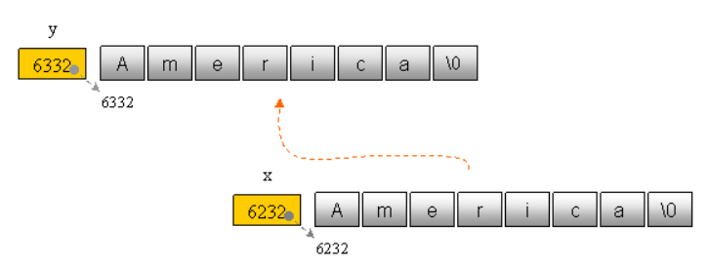
Arrays and Strings
#include<stdio.h>
#include<string.h>
int main()
{
char x[50],y[50];
printf("Enter any string:");
scanf("%s",x);
strcpy(y, x); /* "x" is copied onto "y" */
printf("%s",y);
return 0;
}
Execution:
Enter any string: America
America
Note
If destination string length is less than the source string, entire source string value won’t be copied into destination string
For example, consider destination string length is 20 and source string length is 30. Then, only 20 characters from source string will be copied into destination string and remaining 10 characters won’t be copied and will be truncated

Slide 38
Arrays and Strings
#include <stdio.h>
#include <string.h>
int main( )
{
char source[ ] = “PSG TECH" ;
char target[20]= "" ;
printf ( "\nsource string = %s", source ) ;
strcpy ( target, strcpy (source, “COIMBATORE “)) ;
printf ( "\ntarget string after strcpy( ) = %s", target ) ;
return 0;
}

Slide 39
Arrays and Strings
strncpy() - copies up to ’n’ characters from the string pointed by source to destination
Syntax
char *strncpy(char *dest, const char *src, size_t n)
Example
strncpy ( str1, str2, 4) – It copies first 4 characters of str2 into str1
strncpy ( str2, str1, 7) – It copies first 7 characters of str1 into str2
If destination string length is less than source string, entire source string value won’t be copied into destination string.
For example, consider destination string length is 20 and source string length is 30.
  If you want to copy 25 characters from source string using strncpy( ) function, only 20 characters from source string will be copied into destination string and remaining 5 characters won’t be copied and will be truncated

Slide 40
Arrays and Strings
#include <stdio.h>
#include <string.h>
int main( )
{
char source[ ] = “PSG TECH" ;
char target[20]= "" ;
printf ( "\nsource string = %s", source ) ;
strncpy ( target, source,3 ) ;
printf ( "\ntarget string after strncpy( ) = %s", target ) ;
return 0;
}
source string = PSG TECH
target string after strncpy( ) = PSG

Slide 41
Arrays and Strings
Concatenating a string to another string
strcat() is a predefined function defined within the header file “string.h” used to concatenate a string to another
  To join two strings together
Concatenates the source string at the end of the target string
Syntax
char *strcat(char *destination, const char *source)
  Source string will be appended to destination, while the ‘\0’ at the end of source string will be removed and placing destination string from there
  The size of destination string must be large enough to contain the source string
  Source string may be a character array or a string constant while destination string must be a character array

Slide 42
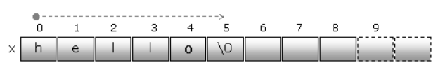
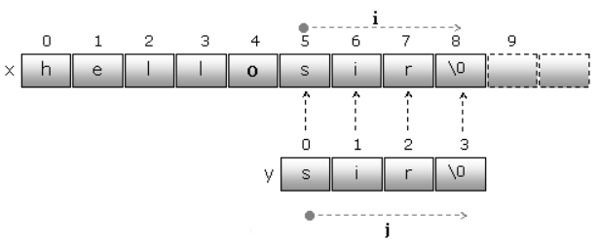
Arrays and Strings
strcat()

Slide 43
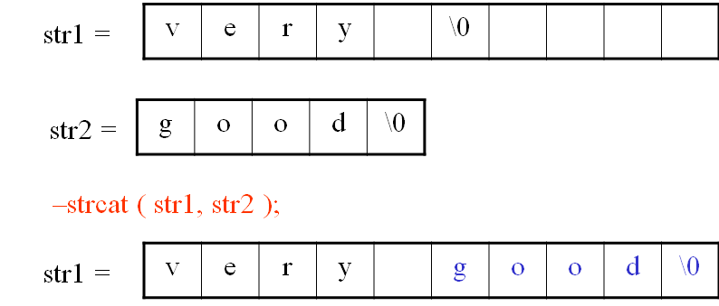
Arrays and Strings
Execution:
Enter the 1st string: very
Enter the 2nd string: good
The resultant string is very good
#include<stdio.h>
#include<string.h>
int main()
{
char str1[50],str2[50];
printf("Enter the 1st string:");
scanf("%s",str1);
printf("Enter the 2nd string:");
scanf("%s",str2);
strcat(str1, str2);
printf("The resultant string is %s",str1);
return 0;
}

Slide 44
Arrays and Strings
#include<stdio.h>
#include<string.h>
int main()
{
char str1[50] = "Hai", str2[50]="Hello", str3[50]="";
strcat(str1, strcat(str2, strcat(str3 ,"everyone")));
// strcat(str1, strcat(str2, strcpy(str3 ,"everyone")));
printf("The resultant string is %s",str1);
return 0;
}

Slide 45
Arrays and Strings
strncat() - appends the string pointed to by src to the end of the string pointed to by dest up to n characters long
Syntax
char *strncat(char *dest, const char *src, size_t n)
dest - This is pointer to the destination array, which should contain a C string, and should be large enough to contain the concatenated resulting string which includes the additional null-character
src - This is the string to be appended
n - This is the maximum number of characters to be appended
strncat ( str2, str1, 3 ); // First 3 characters of str1 is concatenated at the end of str2
strncat ( str1, str2, 5 ); // First 5 characters of str2 is concatenated at the end of str1

Slide 46
Arrays and Strings
Output
Source string = PSG TECH
Target string = CBE-04
Target string after strncat( ) = CBE-04PSG
#include <stdio.h>
#include <string.h>
int main( )
{
char source[ ] = " PSG TECH" ;
char target[ ]= “CBE-04" ;
printf ( "\nSource string = %s", source ) ;
printf ( "\nTarget string = %s", target ) ;
strncat ( target, source, 3 ) ; //strncat(target, “PSG TECH”, 3);
printf ( "\nTarget string after strncat( ) = %s", target ) ;
}

Slide 47
Arrays and Strings
strcmp() – compares two strings
Syntax
int strcmp(const char *string1, const char *string2 );
  string1 and string2 may be character arrays or string constants
  This function returns one of the following three values
    0 if they are equal
    a negative number if the string1 less than string2 (string1 < string2)
      alphabetically string1 precedes string2
    a positive number if string1 greater than string2 (string1 > string2)
      alphabetically string2 precedes string1

Slide 48
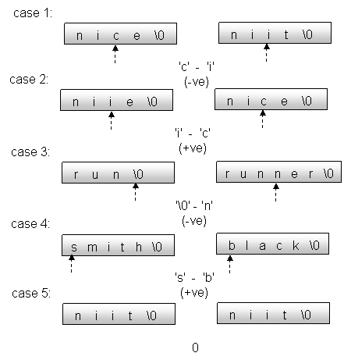
Arrays and Strings
strcmp ()
Different cases

Slide 49
Arrays and Strings
  x = strcmp(“compare”, “computer”);
c | o | m | p | a | r | e | \0
c | o | m | p | u | t | e | r
The following statements are used for determining whether two strings are equal or not
if ( strcmp( str1, str2) == 0 )
printf(“%s is equal to %s”,str1,str2);

Slide 50
Arrays and Strings
int main()
{
char x[50],y[50];
printf("Enter the first string:");
scanf("%s",x);
printf("Enter the second string:");
scanf("%s",y);
if(strcmp(x, y)==0)
printf("Equal");
else if(strcmp(x, y)>0)
printf("Biggest string %s",x);
else
printf("Biggest string %s",y);
return 0;
}
Execution
Enter the first string: hello
Enter the second string: world
Biggest string world

Slide 51
Arrays and Strings
strncmp() - compares at most the first n bytes of str1 and str2
Syntax
int strncmp(const char *str1, const char *str2, size_t n)
Return value of strncmp()
This function compares only the first n (specified number of) characters of strings and returns following value based on the comparison.
  0, if both the strings str1 and str2 are equal
  >0, if the ASCII value of first unmatched character of str1 is greater than str2
  <0, if the ASCII value of first unmatched character of str1 is less than str2

Slide 52
Arrays and Strings
#include <stdio.h>
#include <string.h>
int main () {
char str1[20];
char str2[20];
int result;
//Assigning the value to the string str1
strcpy(str1, "hello");
//Assigning the value to the string str2
strcpy(str2, "helLO WORLD");
//This will compare the first 3 characters
result = strncmp(str1, str2, 3);
if(result > 0) {
printf("ASCII value of first unmatched character of str1 is greater than str2");
} else if(result < 0) {
printf("ASCII value of first unmatched character of str1 is less than str2");
} else {
printf("Both the strings str1 and str2 are equal");
}
return 0;
}
Output : Both the strings str1 and str2 are equal

Slide 53
Arrays and Strings
strcmpi() or stricmp()
  The strcmpi() function is same as that of the strcmp() function but the only difference is that strcmpi() function is not case sensitive and on the other hand strcmp() function is the case sensitive
Syntax
int strcmpi (const char * str1, const char * str2 );
str1: The first string.
str2: The second string.
Returns: This function returns 0 if the given two strings are same, a negative value if the length of str1 is less then the length of str2 and if the length of str1 is greater then str2 then this function returns a positive value

Slide 54
Arrays and Strings
#include <stdio.h>
#include <string.h>
int main( )
{
char str1[ ] = “PSG" ;
char str2[ ] = “psg" ;
int k;
int j = strcmpi ( str1, str2 ) ;
k = strncmpi(str1, str2, 2);
printf ( "The function returns = %d", j ) ;
printf ( "The function returns = %d", k ) ;
return 0;
}
Output:
The function returns = 0
The function returns = 0

Slide 55
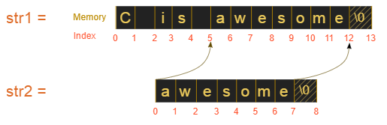
Arrays and Strings
strstr()
This function takes two strings s1 and s2 as arguments and finds the first occurrence of the substring s2 in the string s1
Syntax
char *strstr (const char *s1, const char *s2);
s1: This is the main string to be examined
s2: This is the sub-string to be searched in s1 string
Return Value - This function returns a pointer points to the first character of the found s2 in s1 otherwise a null pointer if s2 is not present in s1.

Slide 56
Arrays and Strings
#include <string.h>
#include <stdio.h>
int main()
{
// Take any two strings
char s1[ ] = “PSG TECH";
char s2[ ] = “TECH";
char * p=NULL;
// Find first occurrence of s2 in s1
p = strstr(s1, s2);
Output:
String found
First occurrence of string ‘TECH' in ‘PSG TECH’ is ‘TECH’
// Prints the result
if (p) {
printf("String found\n");
printf("First occurrence of string '%s' in '%s' is '%s'", s2, s1, p);
} else
printf("String not found\n");
return 0;
}

Slide 57
Arrays and Strings
strrstr( ) - function returns pointer to the last occurrence of the string in a given string
Synax : char *strrstr(const char *str1, const char *str2);
#include <stdio.h>
#include <string.h>
int main ()
{
char string[55] ="This is a test string for testing";
char *p;
p = strrstr (string,"test");
if(p)
{
printf("string found\n" );
printf ("Last occurrence of string \"test\" in \"%s\" is"\
" \"%s\"",string, p);
}
else printf("string not found\n" );
return 0;
}
OUTPUT
string found
Last occurrence of string “test” in “This is a test string for testing” is “testing”

Slide 58
Arrays and Strings
strchr()
used to find the first occurrence of a character chr in a string str
Syntax
char *strchr(const char *str, int c)
str − This is the C string to be scanned.
c − This is the character to be searched in str.
Return Value
This returns a pointer to the first occurrence of the character c in the string str, or NULL if the character is not found

Slide 59
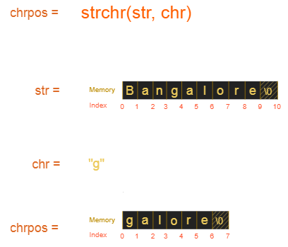
Arrays and Strings

Slide 60
Arrays and Strings
#include <stdio.h>
#include <string.h>
int main()
{
char mystr[30] = "I’m an example of function strchr";
printf ("%s", strchr(mystr, 'f'));
return 0;
}
Output:
f function strchr

Slide 61
Arrays and Strings
strrchr()
It is similar to the function strchr, the only difference is that it searches the string in reverse order
Syntax
char *strrchr(char *str, int ch)
str − This is the C string
c − This is the character to be located. It is passed as its int promotion, but it is internally converted back to char

Slide 62
Arrays and Strings
#include <stdio.h>
#include <string.h>
int main()
{
char mystr[30] = “I am an example of function strchr";
printf ("%s", strrchr(mystr, 'f'));
return 0;
}
Output:
function strchr

Slide 63
Arrays and Strings
strlwr() - used to convert a given string into lowercase
Syntax
char *strlwr(char *str);
str: string which we want to convert into lowercase
Returns: It returns the modified string obtained after converting the characters of the given string str to lowercase
#include<stdio.h>
#include<string.h>
int main()
{
char str[ ] = “PSG";
// converting the given string into lowercase.
printf("%s\n",strlwr (str));
return 0;
}
Output
psg

Slide 64
Arrays and Strings
strupr() - used to converts a given string to uppercase
Syntax
char *strupr(char *str);
str: string which we want to convert into uppercase
Returns: It returns the modified string obtained after converting the characters of the given string str to uppercase
#include<stdio.h>
#include<string.h>
int main()
{
char str[ ] = “Psg Tech";
//converting the given string into uppercase.
printf("%s\n", strupr (str));
return 0;
}
Output:
PSG TECH

Slide 65
Arrays and Strings
strdup() - duplicates the given string
Syntax
char *strdup(const char *string);
#include<stdio.h>
#include<string.h>
int main()
{
char source[ ] = “C Programming";
char* target = strdup(source);
printf("%s", target);
return 0;
}
Output:
C Programming
This function returns a pointer to a null-terminated byte string, which is a duplicate of the string pointed to by s

Slide 66
Arrays and Strings
strtok() - splitting a string by some delimiter
#include <stdio.h>
#include <string.h>
int main()
{
char str[] = “PSG-College-CBE";
char* token = strtok(str, "-");
// Keep printing tokens while one of the
// delimiters present in str[].
while (token != NULL) {
printf("%s\n", token);
token = strtok(NULL, "-");
}
return 0;
}
Output
PSG
College
CBE

Slide 67
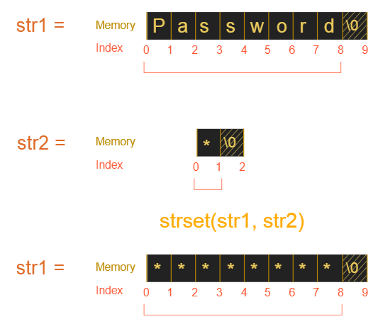
Arrays and Strings
strset() - used to set a particular character to the string

Slide 68
Arrays and Strings
#include <stdio.h>
#include<string.h>
int main()
{
char str[20] = "password";
char chr = '*' ;
strset(str, chr);
printf("str: %s ", str);
return 0;
}
Output
str: ********

Slide 69
Arrays and Strings
strnset()
Sets the first n characters of a string to a given character
Syntax
char *strnset(const char *str, char ch, int n);
str: This is the original string in which some character are replaced by a given character
ch: represents the given character
n: represents the number of characters to be replaced by the given character
Return Value: It returns the modified string obtained after replacing the first characters of the given string str.

Slide 70
Arrays and Strings
#include <stdio.h>
#include <string.h>
int main()
{
char str[] = “PSGTECH";
printf("Original String: %s\n", str);
// First 3 character of string str
// replaced by character '*'
printf("Modified String: %s\n", strnset(str, '*', 3));
return 0;
}
Output:
Original String: PSGTECH
Modified String: ***TECH

Slide 71
Arrays and Strings
Table of strings : Two-dimensional character array can be used to store a list strings.
Syntax : char string-array-name[row-size][column-size];
Example : char weeks[7][10] = {“Sunday”,”Monday”,”Tuesday”,”Wednesday”,
”Thursday”,”Friday”,”Saturday”};
It stores as below
S | u | n | d | a | y | \0
M | o | n | d | a | y | \0
T | u | e | s | d | a | y | \0
W | e | d | n | e | s | d | a | y | \0
T | h | u | r | s | d | a | y | \0
F | r | i | d | a | y | \0
S | a | t | u | r | d | a | y | \0

Slide 72
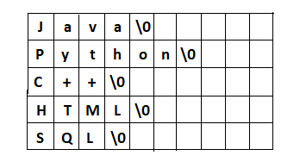
Arrays and Strings
char language[5][10] = {"Java", "Python", "C++", "HTML", "SQL"};
char language[5][10] ={
{'J','a','v','a','\0'},
{'P','y','t','h','o','n','\0'},
{'C','+','+','\0'},
{'H','T','M','L','\0'},
{'S','Q','L','\0'}
};

Slide 73
Arrays and Strings
Reading and displaying 2D array of strings in C
// reading strings using for loop
for(i=0;i<n;i++)
{
scanf("%s[^\n]",name[i]);
}
// displaying strings using for loop
for(i=0;i<n;i++)
{
puts(name[i]); // printf(“%s”, name[i]);
}

Slide 74
Arrays and Strings
#include<stdio.h>
int main()
{
// declaring and initializing 2D String
char language[5][10] = {"Java", "Python", "C++", "HTML", "SQL"};
// Dispaying strings
printf("Languages are:\n");
for(int i=0;i<5;i++)
puts(language[i]);
return 0;
}

Slide 75
Arrays and Strings
Sorting of a Set of Strings in Ascending alphabetical order
#include<stdio.h>
#include<string.h>
int main() {
int i,j,count;
char str[25][25],temp[25];
puts("How many strings?: ");
scanf("%d",&count);
puts("Enter Strings one by one: ");
for(i=0;i<count;i++)
gets(str[i]);
for(i=0;i<count;i++)
for(j=i+1;j<count; j++) {
if(strcmp(str[i],str[j])<0) {
strcpy(temp,str[i]);
strcpy(str[i],str[j]);
strcpy(str[j],temp);
}
}
printf("Order of Sorted Strings:");
for(i=0;i<=count;i++)
puts(str[i]);
return 0;
}

